Slide 2
Expert
Circus
Performance
Novice
Slapstick
Entertainment

Slide 3

Total
View
Circus
Slapstick
Expert
Novice
Performance
Entertainment

Slide 4

Circus
Expert
Slapstick
Total View
Novice
Performance
Entertainment

Slide 5

Circus
40 EA
Expert
33 EA
Slapstick
21 EA
Number of moments
Novice
3 EA
Performance
Entertainment

Slide 6

Circus
143 K
Expert
95 K
Slapstick
121 K
Average view
Novice
86 K
Performance
Entertainment

Slide 7

Circus
4.85 M
Expert
2.79 M
Total view
Slapstick
1.84 M
Novice
0.2 M
Performance
Entertainment

Slide 8
3
21
33
Novice
Slapstick
Expert
Circus
40

Slide 9
31%
29%
Novice
Slapstick
Expert
Circus
36%
42%

Slide 10
Circus
Fortune
Setup Time
Control View

Slide 11
Start
Chase
Result
Damaged
Searching
Stealth
Detected
Attack
Defence
or
Escape
Start
Chase
Result
Tension
Chase Process

Slide 12
Start
Chase
Result
Tension
Chase Process

Slide 13
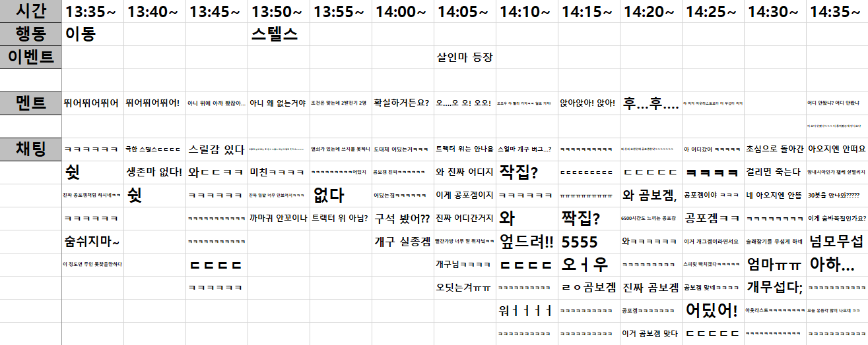
Intro
Chase
Ending

